Slide 1

A Student’s Dilemma: Rent Or Buy ?
OPIM 5641
Business Decision Modelling
GROUP 6
Abhinav Dubey
Shanmukha Hemanth Reddy Indla
Supriya Movva
Notes:
Hello everyone! This is group 6 and Our presentation today will be on a student’s Dilemma to Rent apartment or to Buy a house? along with the analysis we came up with. Our team members include Shanmukha, Supriya and myself Abhinav. So let us begin.

Slide 2

Agenda
Business Background
Decision Making
Decision Analysis
Conclusion
Recommendations
1
Notes:
Before going over our case analysis, we would like to share the agenda for today’s presentation. We’ll start with the business Background and explain the decision making followed by the decision analysis. We will then move on to conclude giving some recommendations.

Slide 3

Business Background
Problem Description
Scott and four of her friends were looking for a 5-bedroom flat with at least 2 bathrooms. Scott has two options to do so
Scott can purchase a house and charge her four roommates inclusive or non-inclusive rent
OR
Scott can rent an apartment (inclusive or non-inclusive rent) along with her friends
2
Notes:
Let's come to the problem statement. Scott and four of her friends were looking for a 5-bedroom flat with at least 2 bathrooms. Scott has two options to do so first is Scott can purchase a house and charge her four roommates inclusive or non-inclusive rent and second is Scott can rent an apartment (inclusive or non-inclusive rent) along with her friends.
We need to analyze the costs and benefits of buying a house and renting the property to conclude whether it would be profitable to purchase the house or rent it.

Slide 4
Business Background
Inclusive
$510 per person/month
Landlord pays for utilities
Non-inclusive
$435 per person/month
Utilities not included
- Heat - $120 every 3 month
- Hydro and gas - $100 every month
- Water Heater- $30 every month
Rent
3
Notes:
In this slide we can see what all costs Scott needs to consider if she rents an apartment with her friends. For renting we have two options first is Inclusive of all the utilities, so the rent would be 510 per person/ month and the second option is Non – inclusive of all the utilities so the rent would be $435 per person/ Month plus utility bills as shown in slide.

Slide 5
Business Background
Purchase
What costs will Scott have to consider?
Savings : $25,000
Parents match for down payment
Annual property tax (1.4427% of house value, increasing with higher house price
Annual insurance : $1200
Maintenance costs : $6000 for three years
3 years closed mortgage with 3.95% interest rate over 25 years (20% down)
Utilities : Water, Gas, and Hydro
Internet and cable: $70 monthly for 8 months (1 year with
4-month-empty-house)
House price expected to increase 2% annually
Real estate agent would charge 5% commission fee of final price
4
Notes:
In this slide we can see what all costs Scott needs to consider if she purchase a house. Important factors and costs scotts into consideration when buying the house are: a down payment of at most $50,000 including $25,000 of her own and $25,000 from her parents, annual property tax (1.4427% of the house value and increasing with higher house prices), annual
insurance of $1200, maintenance costs of $6000 for three years, three years closed mortgage with 3.95% interest rate over 25 years (if she puts 20% down), utilities would be $130/month for hydro and gas that are adjustable by season: $195 from November to February and $65 from May to August, $120/three months for water heater, and an additional 20% costs of utilities if inclusive, internet and cable will be $70 monthly for 8 months (1 year with 4-month-empty-house), the house prices are expected to increase 2% annually, and the real estate agent would charge a 5% commission fee of the final price.
Which you can see in the slide

Slide 6

Business Background
Buying Concerns
Scott is solely responsible for issues and expenses
Stress can hinder academic performance
Can’t sell the house until three years after purchase
Is it worth it?
5
Notes:
Concerns if Scott purchase a house. Scott is solely responsible for any expenses and issues with the house because she will be the owner.
It is of concern to Scott that the time and effort to take care of the house may not be worth the profit. Will she also be able to maintain good grades if she is spending time on the accounting and house issues?
Scott can’t sell the house until the end of three years - so there is no backing out.
Is it worth it ?
Now Supriya will tell you about decision making.

Slide 7
Decision Making
Scott’s Final Bank Account Balance
Buy: Inclusive rent
to roommates
$49,534.08
Rent: Inclusive
$7,115.22
Buy: Non-inclusive rent
to roommates
$44,782.45
Rent: Non-inclusive
$8,613.95
6
Notes:
Thank you Abhinav for handing it over.
Now that the problem statement is clear, the main decision that Scott needs to make is whether to buy or rent a house.
For each solution, there are two scenarios that Scott needs to consider.
In the case of buying, Scott needs to decide,
1. Whether she has to rent it to her friends inclusive or non-inclusive of all utilities
In the case of renting along with her friends, Scott needs to decide,
1. Whether she has to rent a house with or without utilities.
For all the four scenarios, we have calculated the final bank balance that Scott will be left with after three years.
From the numbers on the slide, we can observer that if Scott has decided to rent a house, she will end up with the final balance roughly around $7000 to $8000. But if Scott decided to buy a house, she will end up with the final balance around $44,000 to $45,000 which is far more profitable When compared to renting a house.
So from these numbers, we can conclude that the best choice for Scott is to buy a house and rent it to her friends inclusive of all utilities.
We will explore further on how we arrived at these numbers in the coming slides

Slide 8



Decision Analysis
Base Case Analysis
Break Even Analysis
Risk Analysis
7
Notes:
Decision Analysis:
Here are three analyses we ran while we evaluated the Scott’s situation
We have run the base case analysis to understand whether buying or renting would be an optimal decision for Scott.
We also have considered best and worst case scenarios for the house price increase rate variable.
After that, we have run Break even analysis, to find out the break even point for the rent amount at which the final balance of buying equals renting.
Finally, we have considered few risks that might occur in the case of buying.
The risks that we have considered are, a friend dropping out from the lease,
Fluctuations in bank interest rate and house price increase rate.

Slide 9

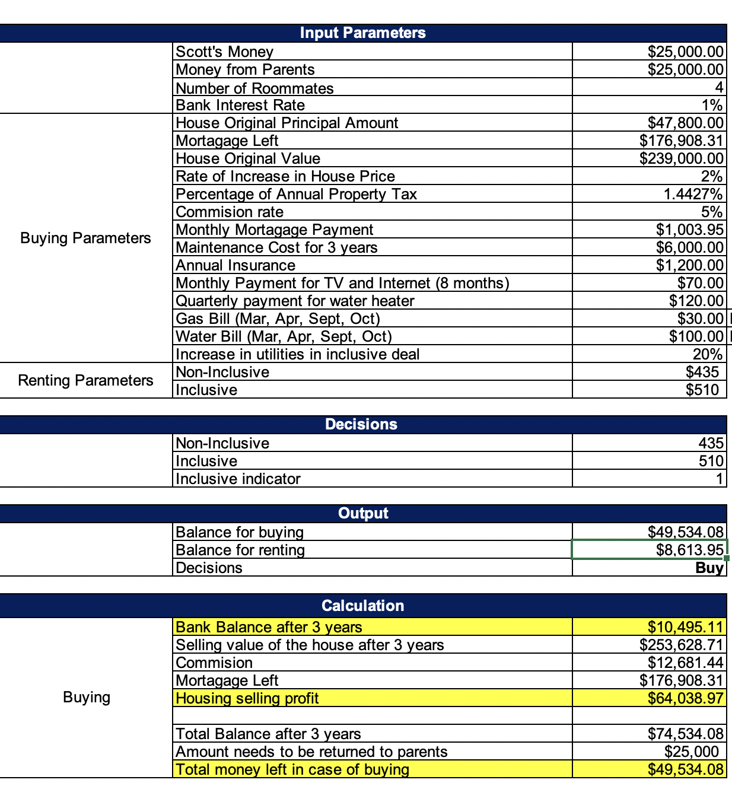
Base Case Analysis
8
Notes:
Base Case Analysis:
In the base case, numbers are fixed in the case of renting. Her monthly rent would be deducted for three years from her bank balance.
There are no external estimates that needs to be incorporated in calculating the final balance. The final bank balance in renting scenarios are 7.1k and 8.6k.
But in the case of buying, estimated values are used for a few variables that can impact the final bank balance significantly. Variation in House price rate is making a significant impact on the final balance. Therefore, we have explored the Best and Worst case scenarios for House price increase rate

Slide 10
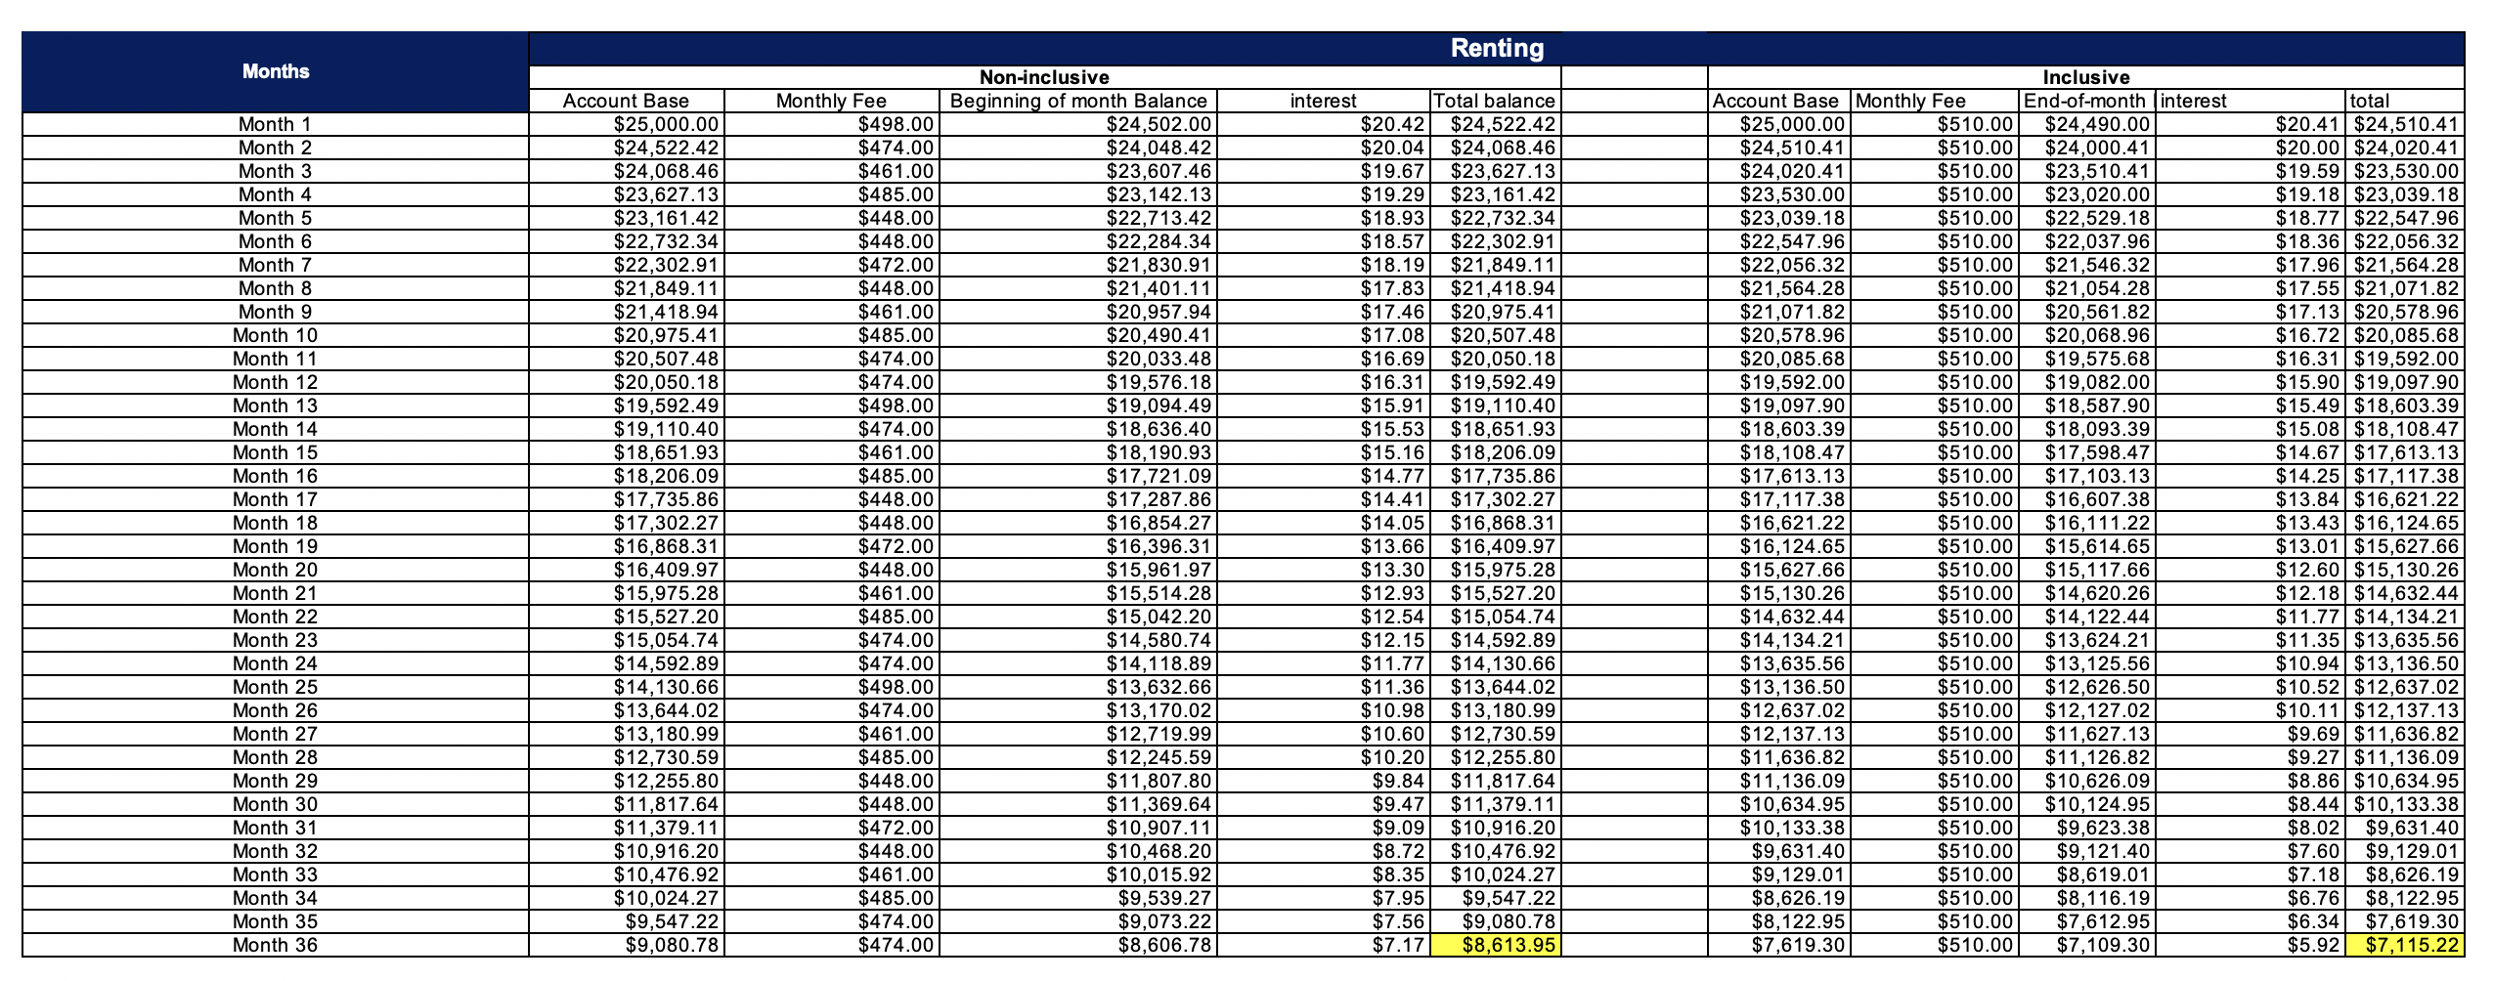
Base Case Analysis
9
Notes:
Base Case Analysis:
In the base case, numbers are fixed in the case of renting. Her monthly rent would be deducted for three years from her bank balance.
There are no external estimates that needs to be incorporated in calculating the final balance. The final bank balance in renting scenarios are 7.1k and 8.6k.
But in the case of buying, estimated values are used for a few variables that can impact the final bank balance significantly. Variation in House price rate is making a significant impact on the final balance. Therefore, we have explored the Best and Worst case scenarios for House price increase rate

Slide 11
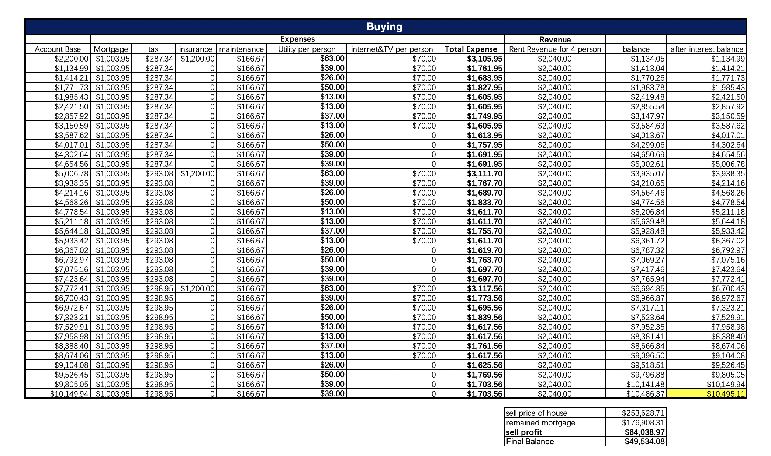
Base Case Analysis
10
Notes:
Base Case Analysis:
In the base case, numbers are fixed in the case of renting. Her monthly rent would be deducted for three years from her bank balance.
There are no external estimates that needs to be incorporated in calculating the final balance. The final bank balance in renting scenarios are 7.1k and 8.6k.
But in the case of buying, estimated values are used for a few variables that can impact the final bank balance significantly. Variation in House price rate is making a significant impact on the final balance. Therefore, we have explored the Best and Worst case scenarios for House price increase rate

Slide 12
Base Case Analysis
Rent: Inclusive
$7,115.22
Purchase:
Inclusive
TBD
Purchase:
Non-inclusive
TBD
Rent : Non-inclusive
$8,613.95
11
Notes:
Base Case Analysis:
In the base case, numbers are fixed in the case of renting. Her monthly rent would be deducted for three years from her bank balance.
There are no external estimates that needs to be incorporated in calculating the final balance. The final bank balance in renting scenarios are 7.1k and 8.6k.
But in the case of buying, estimated values are used for a few variables that can impact the final bank balance significantly. Variation in House price rate is making a significant impact on the final balance. Therefore, we have explored the Best and Worst case scenarios for House price increase rate

Slide 13

Best & Worst Scenarios
: House Price Increase Rate
Inclusive: If Scott would like to charge inclusive rent of $510, with the current rate her balance is $49,534.08. Optimistically, the balance increases to $109,922.25. Pessimistically, the balance decreases to $10,088.06.
Non-Inclusive: If Scott would like to charge non-inclusive rent of $435, with the current rate her balance is $44,782.45. Optimistically, the balance increases to $105,170.62. Pessimistically, the balance decreases to $5,336.43.
-4% -> 10,088.06
2% -> $49,534.08
10% -> $109,922.25
-4% -> 5,336.43
2% -> $44,782.45
10% -> 105,170.62
Inclusive
Non-inclusive
Base
Base
Base
Optim
-istic
Optim
-istic
Pessim
-istic
Pessim
-istic
12
Notes:
Best or Worst Case Scenario:
Here in best case, worst case scenario, we have defined base value as 2% and from our research we observed that the house price increase rate ranges between -4% to 10%. These are our pessimistic and optimistic values.
From the numbers you can see that for non-inclusive scenario, the final balance is going down to $5,336 which makes renting a house profitable. Other than this scenario, every other scenario validates the base case that buying house is profitable for Scott.
Therefore, when buying and selling a house, knowledge related to market should be researched and considered.

Slide 14
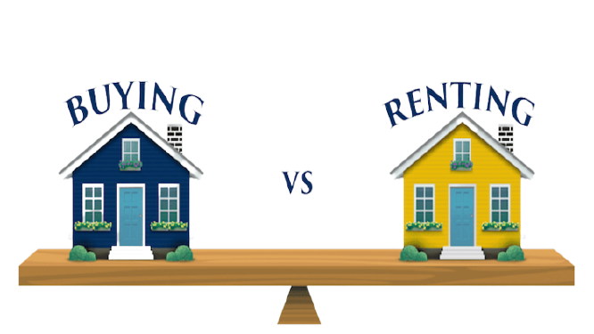
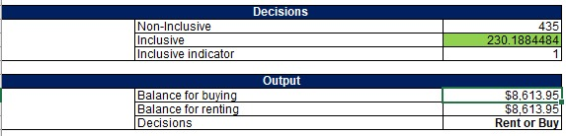
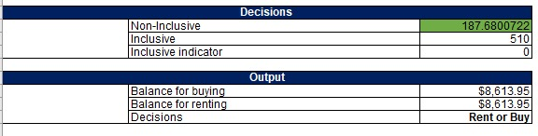
Break Even Analysis
For utilities included, Scott has to charge at least $230.18 to maintain higher balance after buying a house than renting
For utilities not included, Scott has to charge at least $187.68 to maintain higher balance after buying a house than renting
Break Even Point = $8,613.95
Inclusive
Non-inclusive
13
Notes:
Break - Even Analysis:
We know that in the case of renting, Scott’s friends are getting an inclusive house for $510 and non-inclusive house for $435. If Scott charges beyond these values, there is a possibility that Scott’s friend might chose renting an other house.
If Scott charges the same prices, she would get maximum profit of around $49,000 for inclusive and $44,000 for non-inclusive.
If Scott want’s to reduce the charge for her friends, we wanted to see how much amount she can reduce so that she can still make a profit
In the case of buying.
Through, break-even analysis, we identified that Scott should not charge less than $230 for inclusive and $187 for non-inclusive
To maintain higher balance.
We also have considered few risks that might occur when Scott decides to buy a house and Hemanth will continue with Risk Analysis.

Slide 15
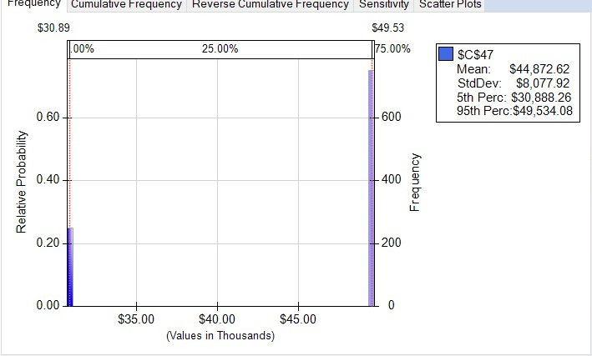
Risk Simulation: Chances of one of Scott's friend dropping out
We have taken 25% of the chance that a roommate will drop out and Scott has to take care of the expenses to cover for the costs of one less roommate.
After the analysis, it seems that the final balance decreases from $49,534.08 to $30,888.26 if Scott purchases the house and rents it to her friends at $510 per month.
14
Notes:
In this model we are interested in finding the drop in Scott’s final bank balance, if one of her roommate drops off from the plan, we took a 25% chance that one of her friends drops off from the plan and ran a simulation analysis.
We found that the bank balance shows a significant drop from 49.5k to 30.8k, This shows that Scott should make sure that all the 4 of her friends stays with her for the next three years

Slide 16
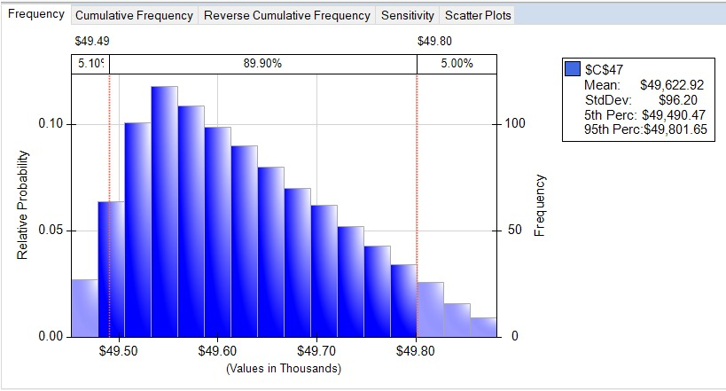
Risk Simulation: Fluctuations in bank interest rate
If we change the deterministic value of 1% annual bank interest rate to a triangular probability distribution ranging between 0.5% to 2%, the difference is not that significant (~$400).
Therefore, we can see that the fluctuations in bank interest rate does not impact Scott's final decision and also the final balance left after buying.
15
Notes:
In this model we are interested in finding the impact of bank rate on Scotts final Bank balance. We assumed that the bank interest rate follows a triangular distribution with min value of 0.5% most likely value of 1% and max value of 2%. We ran the simulation analysis and found that the bank balance lies between 49.8k and 49.5k for 90% of the times. This shows that there is not significant impact of bank interest rate on scotts final bank balance

Slide 17
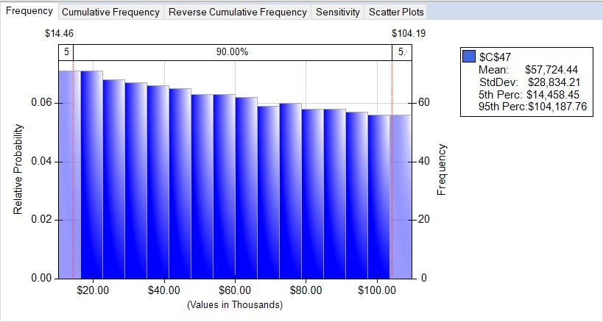
Risk Simulation: Fluctuations in house price increase rate
From our research, we have identified that the change in rate of house price varies between -4% and 10%.
The analysis shows that there is a 5% chance that Scott would make less than $14,458.45 which is significantly higher than $8,613.95 which she would save in the scenario of renting a house rather than buying one
16
Notes:
In this model we are interested in finding the impact of house price increase rate on Scotts final Bank balance. We assumed that the house price increase rate follows a uniform distribution with min value of -4% and max value of 10%. We ran the simulation analysis and found that the bank balance lies between 14.4k and 104k for 90% of the times. This shows that there is significant impact of House price increase rate on scotts final bank balance.

Slide 18

Conclusion
Scott must weigh a number of factors before reaching a decision that would have a significant effect on her bank account for the next three years.
We analyzed Scott's finances over three years based on renting or buying a house using the details provided and Excel Analytic Solver.
Our final recommendation buying the house is the most optimal decision for Scott. As it is the most financially favorable to Scott and will provide her with a stable financial position after she graduates from college and begins her career.
17
Notes:
To reach at a conclusion, Scott needs to consider many factors before finalising a decision which can have a significant impact on her bank account for another three years. We saw Scotts’s financial analysis for three years based on rental and buying options using Excel solver with the details provided. So we as a group came to the conclusion that buying the house is the most profitable option which is financially favourable for her.

Slide 19
Recommendations
Based on quantitative analysis, Scott is recommended to
Buy a house at $239K
Rent the house at $510 per person inclusive of all utilities charges to her four friends
We also recommend Scott to consider
Stress caused from being responsible for house related issues
Time spent in house maintenance
Impact on academic performance
To make an agreement with her friends that they will not leave the house for next three years
18
Notes:
So our recommendation to Scott is that she can buy a House for $239K and can rent the house for $510 per person each month which is inclusive of all utilities for her four friends based on quantitative analysis. But considering the facts of a house owner’s responsibility and the time which can be spent for it, Scott should take care that it is not having a negative impact on her academic performance. She also should make sure that she is making an agreement with her friends that they will not leave the house for next three years.

Slide 20

Any Questions?

Slide 21

Thank You !!!

